Slide 1
INTRODUCTION TO HTML
BY HAJJAT HADIJAH KYAMPEIRE

Slide 2
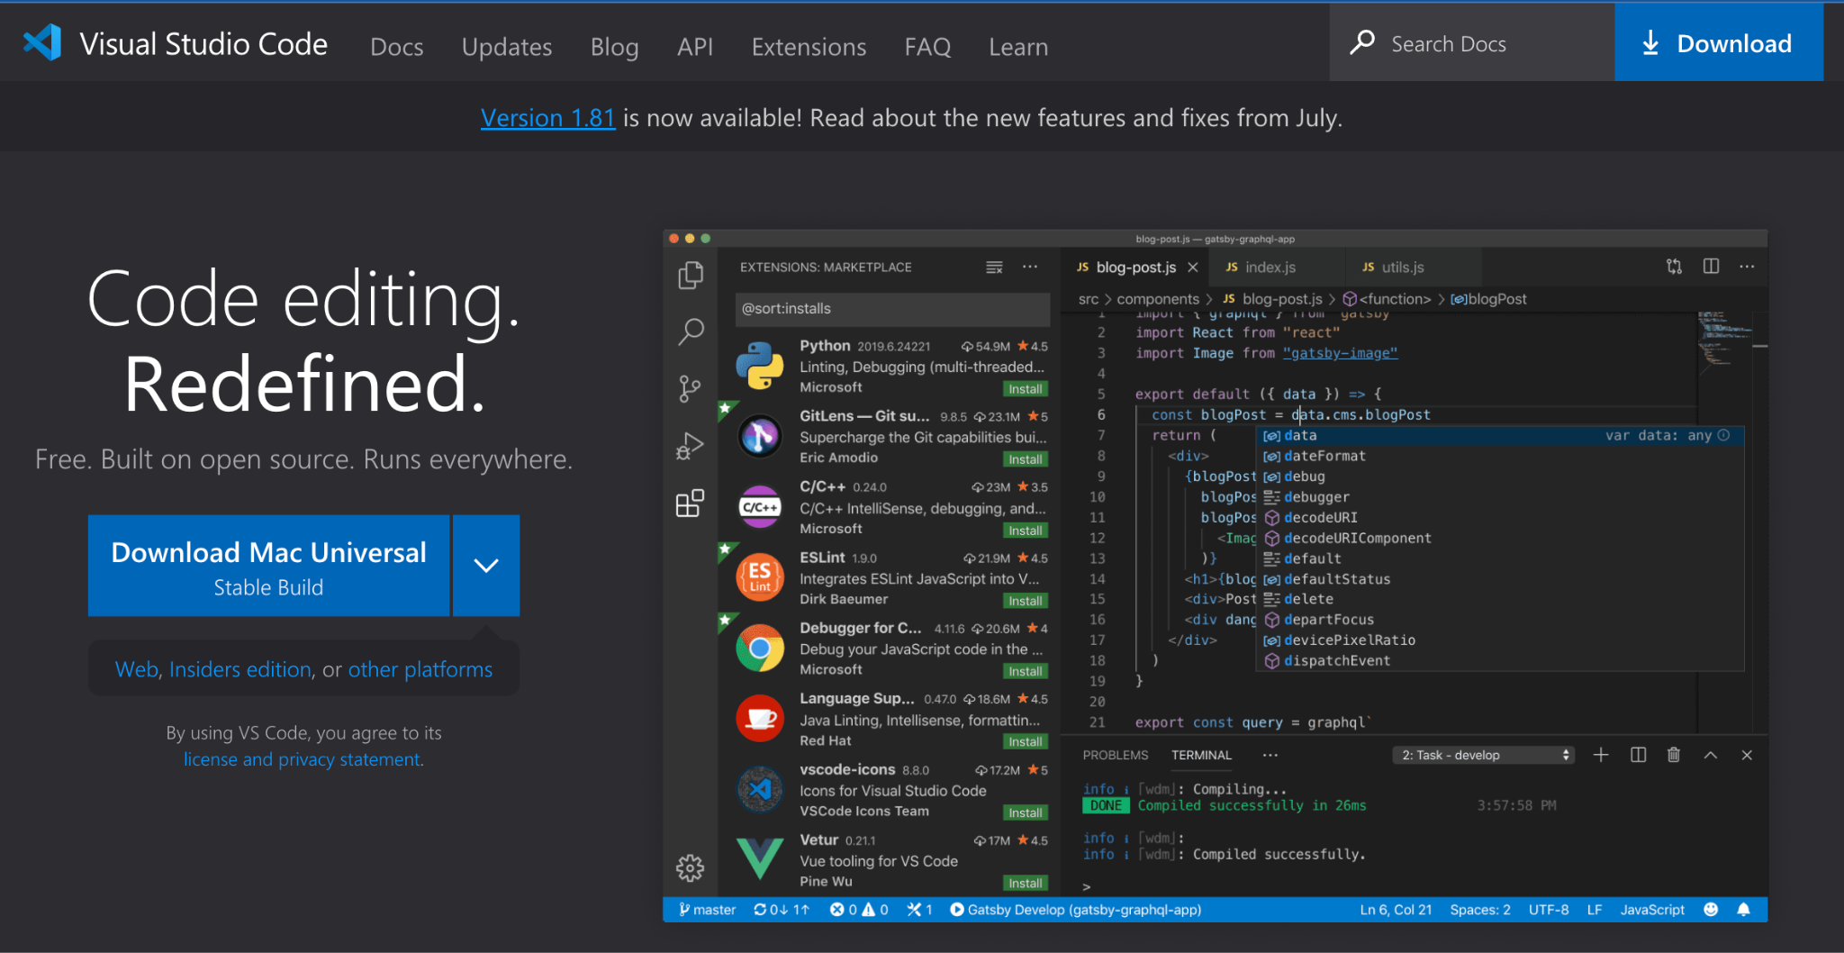
WHAT WE NEED TO GET STARTED (TEXT EDITOR)
Step 1: Open Notepad (PC)
Windows 8 or later: Open the Start Screen (the window symbol at the bottom left on your screen). Type Notepad.
Windows 7 or earlier: Open Start > Programs > Accessories > Notepad
Step 1: Open TextEdit (Mac)
Open Finder > Applications > TextEdit
Also change some preferences to get the application to save files correctly.
In Preferences > Format > choose "Plain Text"
Then under "Open and Save", check the box that says "Display HTML files as HTML code instead of formatted text".
Then open a new document to place the code.
BUT we are going to opt to use Vscode since it comes with more power and you can write many languages in it.

Slide 3
INTRODUCTION
HTML is the standard markup language for creating Web pages.
HTML stands for Hyper Text Markup Language
HTML is the standard markup language for creating Web pages
HTML describes the structure of a Web page
HTML consists of a series of elements
HTML elements tell the browser how to display the content
HTML elements label pieces of content such as "this is a heading", "this is a paragraph", "this is a link", etc.

Slide 4
Example HTML code
<!DOCTYPE html>
<html>
<head>
<title>Page Title</title>
</head>
<body>
<h1>My First Heading</h1>
<p>My first paragraph.</p>
</body>
</html>

Slide 5
Example explained
The <!DOCTYPE html> declaration defines that this document is an HTML5 document
The <html> element is the root element of an HTML page
The <head> element contains meta information about the HTML page
The <title> element specifies a title for the HTML page (which is shown in the browser's title bar or in the page's tab)
The <body> element defines the document's body, and is a container for all the visible contents, such as headings, paragraphs, images, hyperlinks, tables, lists, etc.
The <h1> element defines a large heading
The <p> element defines a paragraph

Slide 6
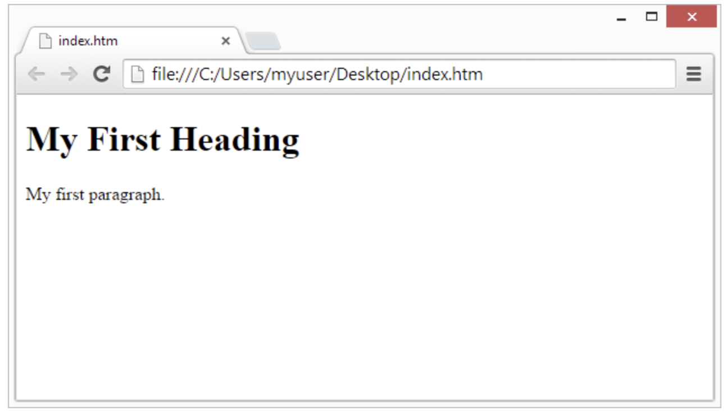
HTML Element
An HTML element is defined by a start tag, some content, and an end tag: <tagname> Content... </tagname>
The HTML element is everything from the start tag to the end tag:
<h1>My First Heading</h1><p>My first paragraph.</p>
Web Browsers
The purpose of a web browser (Chrome, Edge, Firefox, Safari) is to read HTML documents and display them correctly. A browser does not display the HTML tags, but uses them to determine how to display the document:

Slide 7
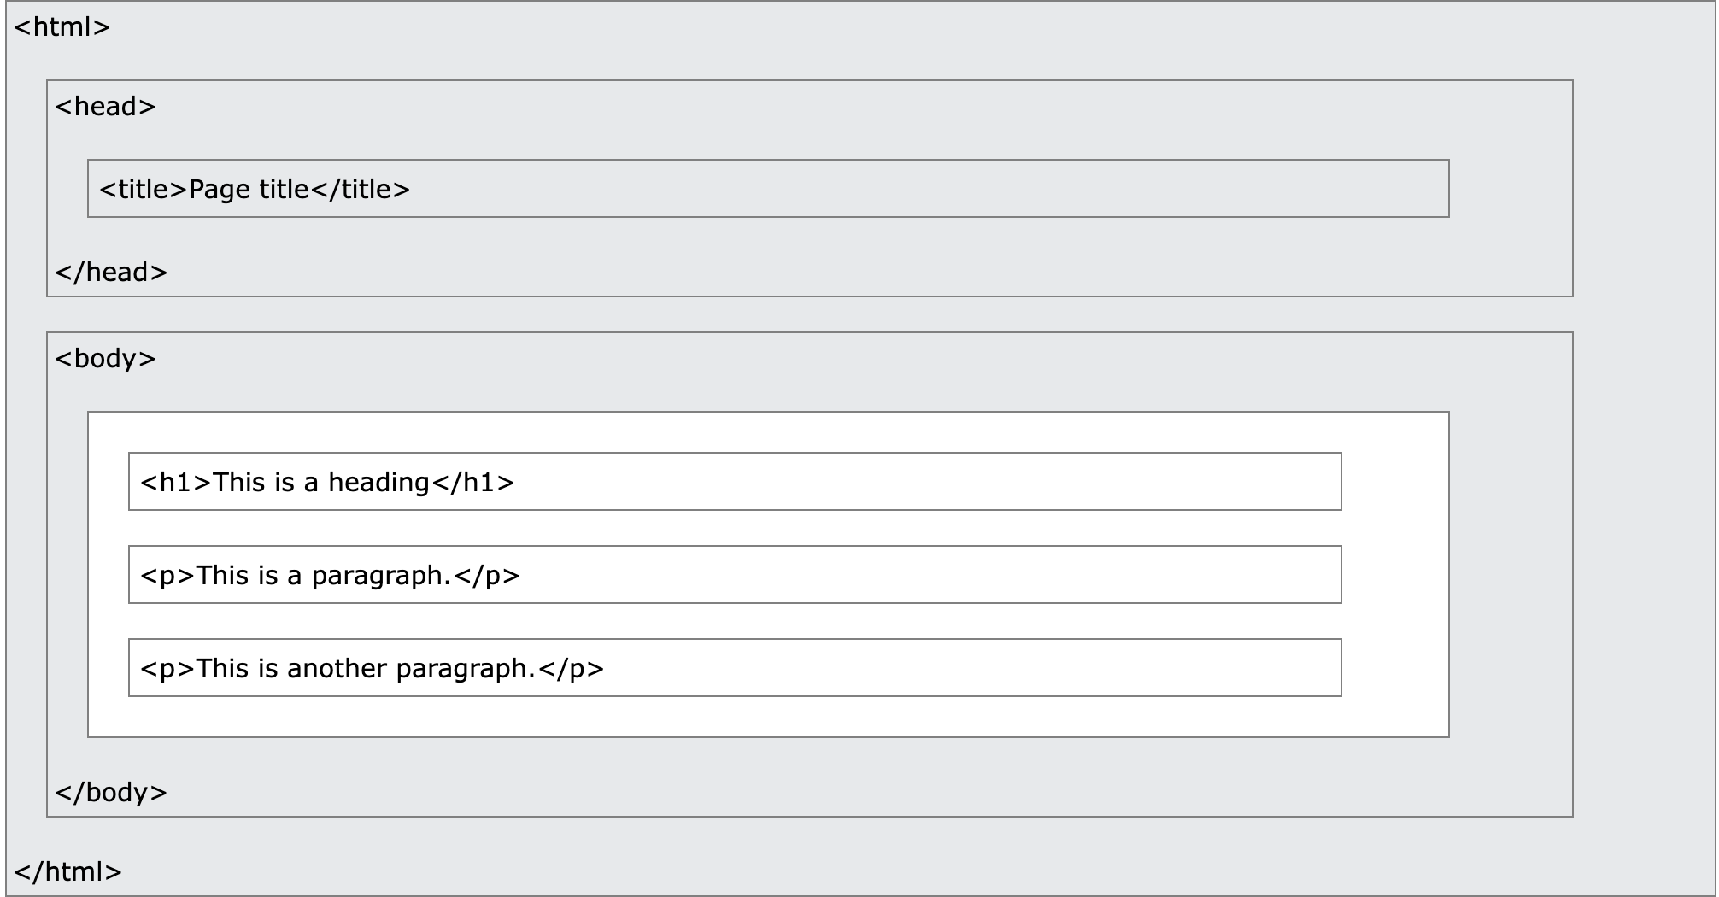
HTML Page Structure

Slide 8
HTML Document
All HTML documents must start with a document type declaration: <!DOCTYPE html>.
The HTML document itself begins with <html> and ends with </html>.
The visible part of the HTML document is between <body> and </body>.
The <!DOCTYPE> declaration represents the document type, and helps browsers to display web pages correctly.
It must only appear once, at the top of the page (before any HTML tags).
HTML Headings
HTML headings are defined with the <h1> to <h6> tags.
<h1>This is heading 1</h1>
<h2>This is heading 2</h2>
<h3>This is heading 3</h3>

Slide 9
HTML Paragraphs
HTML paragraphs are defined with the <p> tag:
<p>This is a paragraph.</p>
<p>This is another paragraph.</p>
HTML Links
HTML links are defined with the <a> tag: <a href="https://www.w3schools.com">This is a link</a>
The link's destination is specified in the href attribute.
Attributes are used to provide additional information about HTML elements.
HTML Images
HTML images are defined with the <img> tag. The source file (src), alternative text (alt), width, and height are provided as attributes:
<img src="w3schools.jpg" alt="W3Schools.com" width="104" height="142">

Slide 10
HTML Styles
The HTML style attribute is used to add styles to an element, such as color, font, size, and more.
The HTML Style Attribute
Setting the style of an HTML element, can be done with the style attribute. The HTML style attribute has the following syntax: <tagname style="property:value;">. The property is a CSS property. The value is a CSS value.
Background Color
The CSS background-color property defines the background color for an HTML element.
<body style="background-color:powderblue;">
<h1>This is a heading</h1>
<p>This is a paragraph.</p>
</body>

Slide 11
Text Color
The CSS color property defines the text color for an HTML element:
<h1 style="color:blue;">This is a heading</h1> <p style="color:red;">This is a paragraph.</p>
Fonts
The CSS font-family property defines the font to be used for an HTML element:
<h1 style="font-family:verdana;">This is a heading</h1> <p style="font-family:courier;">This is a paragraph.</p>
Text Size
The CSS font-size property defines the text size for an HTML element:
<h1 style="font-size:300%;">This is a heading</h1> <p style="font-size:160%;">This is a paragraph.</p>
Text Alignment
The CSS text-align property defines the horizontal text alignment for an HTML element:
<h1 style="text-align:center;">Centered Heading</h1> <p style="text-align:center;">Centered paragraph.</p>

